Slide 1
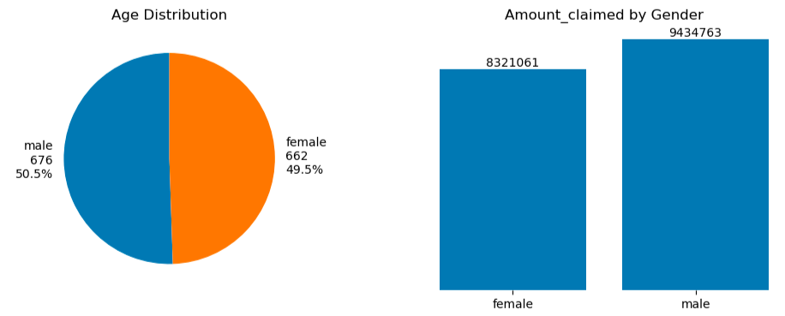
Analysis
1. Does the gender of the person matter for the company as a constraint for extending policies?
Out of total data we have 14 males more than female, but coming to amount claimed Rs.11,13,703 is claimed more than females
Avg. cost per female = Rs.12,570
Avg. cost per male = Rs.13,957

Slide 2
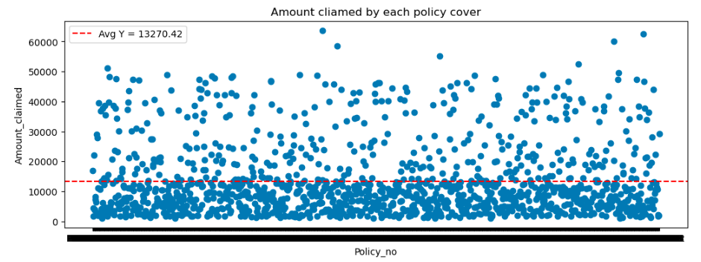
2. What is the average amount of money the company spent over each policy cover?
Rs. 13,270 .42 is the average amount of money spent by the company over each policy cover

Slide 3
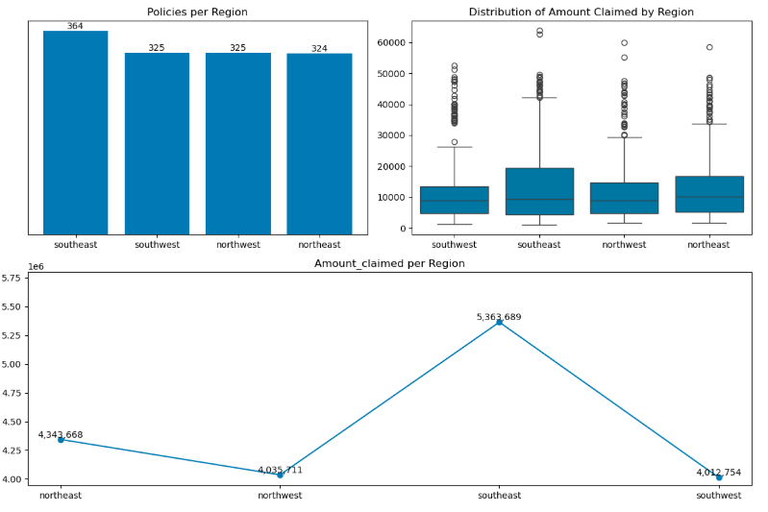
3. Could you advice if the company needs to offer separate policies based upon the geographic location of the person?
Average cost per North_East Region : Rs.13407
Average cost North_West Region : Rs.12418
Average cost per South_East Region : Rs.14736
Average cost South_West Region : Rs.12347
North_East Region and South_East Region : are incurring more cost

Slide 4
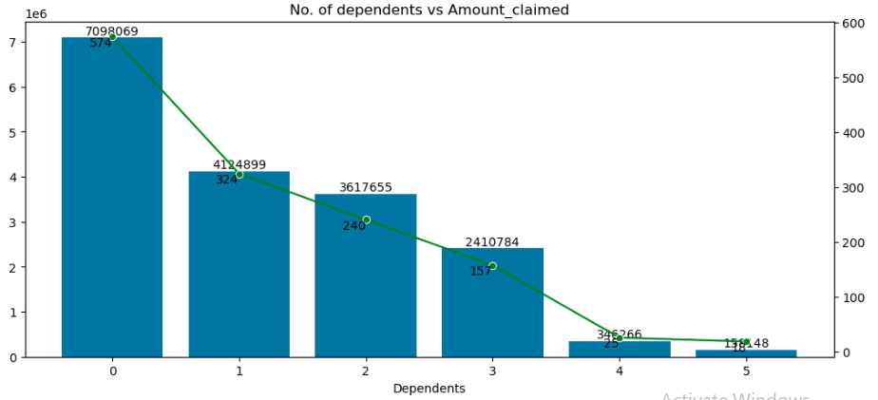
4. Does the no. of dependents make a difference in the amount claimed?
Average cost per 0 dependents : Rs.12366
Average cost per 1 dependent : Rs.12732
Average cost per 2 dependents : Rs.15074
Average cost per 3 dependents : Rs.15356
Average cost per 4 dependents : Rs.13851
Average cost per 5 dependents : Rs.8787
Avg. cost for 2,3,4 dependents is high than avg. amount per policy
Avg. cost of persons with 5 dependents is very low compared 0,1 dependents

Slide 5
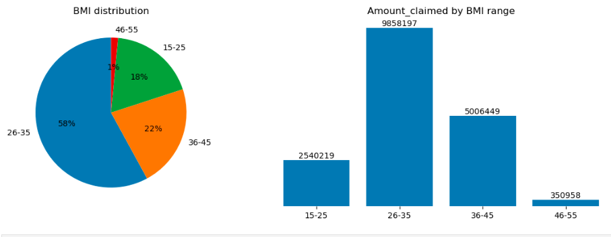
5. Does a study of persons BMI get the company any idea for the insurance claim that it would extend?
Average cost per BMI_range 15-25 : Rs.10285
Average cost BMI_range 26-35 : Rs.12721
Average cost per BMI_range 36-45 : Rs.16914
Average cost BMI_range 46-55 : Rs.17548
Persons with BMI >35 are incurring more cost i.e., more than avg. cost per policy, try to increase premium cost for those who has BMI >35

Slide 6
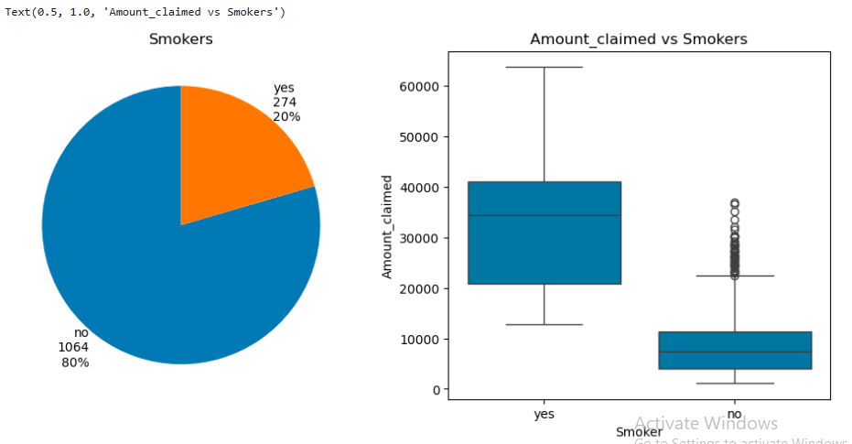
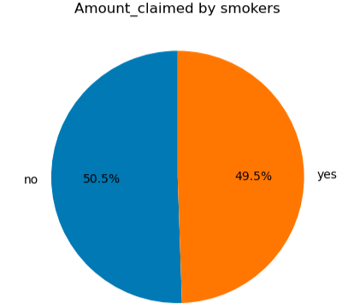
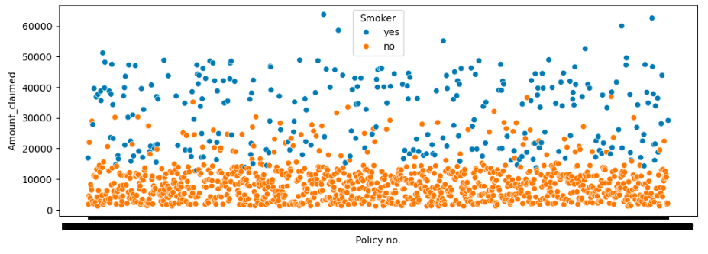
6. Is it needed for the company to understand whether the person covered is a smoker or a non-smoker?
Though smokers contribute to only 20% of policies provided, they claim almost 50% of the amount provided by company to overall policy holders
Average cost per Smoker : Rs.32051 which is 242% more than the total avg. cost
Average cost per Non-smoker : Rs.8435

Slide 7
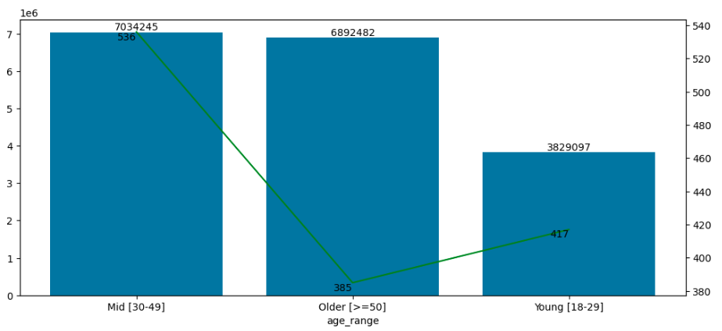
7. Does age have any barrier on the insurance claimed?
Average cost per Age_group 18-29 : Rs.9183
Average cost per Age_group 30-49 : Rs.13124
Average cost per Age_group >50 : Rs.17903
Most of the cost is incurred by persons with age group >50 , We can see the average cost for persons with age > 50 is 35% more than the avg. cost per person

Slide 8
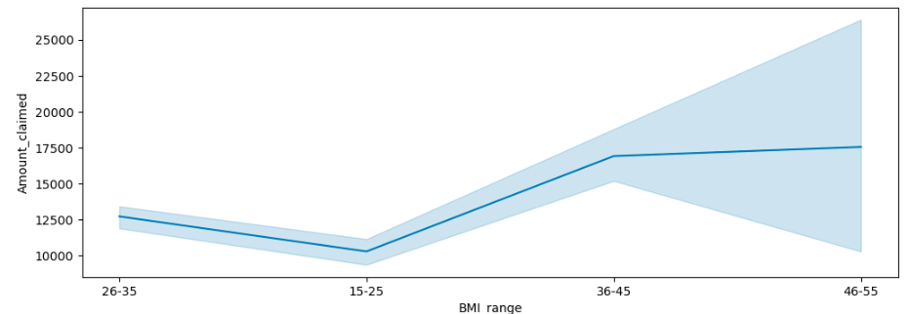
8. Can the company extend certain discounts after checking the health status (BMI) in this case?
We can see the trend like as the BMI increases the cost for the company increases
Persons with BMI <35 are incurring less cost i.e., less than avg. cost per policy, try to give discounts for those who has BMI <35

Slide 9
Suggestions
Try to increase premium
Age: >50
BMI: >35
Dependents: 2,3,4
Smokers: Yes (Costs 242% more than the total avg. cost per policy)
Region: Northeast and Southeast Regions
Gender: Males (accounted for 53.14% of Sum of charges in INR.﻿)
Pricing:
Try to increase premium based on the percentage increase in total average cost per policy and give discounts to those whose has average cost less than total average per policy

